Slide 1
What is Maven:
Maven is a project management tool that is based on POM (project object model). It is used for projects build, dependency and documentation.
It simplifies the build process.
Why Maven Required
Maven project eliminates the Adding set of Jars in each project.
It Creates write Project Structure.
Building and Deploying the project is very simple.
What is Build Tool
A build tool takes care of everything for building a process. It does following:
Generates source code
Compiles source code
Packages compiled code into JAR of ZIP file
Installs the packaged code in local repository, server repository, or central repository

Slide 2
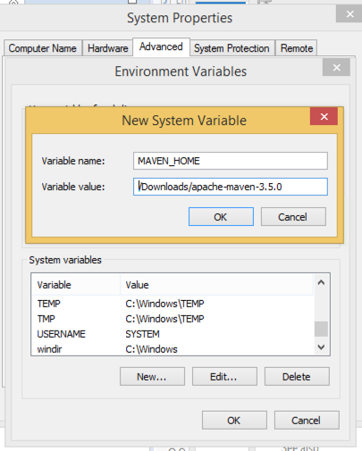
How to install Maven in Window machine
Download maven and extract it
Add JAVA_HOME and MAVEN_HOME in environment variable
Add maven path in environment variable
Verify Maven
apache-maven-3.5.0-bin.zip

Slide 3
Verify maven
To verify whether maven is installed or not, open the command prompt and write:
mvn −version
Maven home: E:\apache-maven\apache-maven-3.3.9\bin
Java version: 1.8.0_102, vendor: Oracle Corporation
Java home: C:\Program Files\Java\jdk1.8.0_144\bin
Maven Repository
There are 3 types of maven repository:
Local Repository
Central Repository
Remote Repository
Maven searches for the dependencies in the following order:
Local repository then Central repository then Remote repository.
Local Repository: Means .m2 folder in your system
Central Repository: Maven central repository is located on the web. It has been created by the apache maven community itself
Remote Repository: Company Specific Library or Custom Library

Slide 4
<project xmlns="http://maven.apache.org/POM/4.0.0" xmlns:xsi="http://www.w3.org/2001/XMLSchema-instance"
xsi:schemaLocation="http://maven.apache.org/POM/4.0.0 http://maven.apache.org/xsd/maven-4.0.0.xsd">
<modelVersion>4.0.0</modelVersion>
<groupId>com</groupId>
<artifactId>Cucumber</artifactId>
<version>0.0.1</version>
<packaging>jar</packaging>
<name>selenium</name>
<url>http://maven.apache.org</url>
<dependency>
<groupId>org.seleniumhq.selenium</groupId>
<artifactId>selenium-java</artifactId>
<version>3.5.1</version>
<scope>test</scope>
</dependency>
</dependencies>
</project>

Slide 5
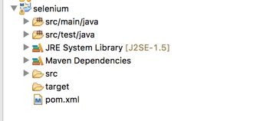
Project: It is the root element of pom.xml file
Model Version: It is the sub element of project. It specifies the model Version. It should be set to 4.0.0
Group Id: will identify your project uniquely across all projects (com.test.selenium)
Artifact Id: project name
Packaging: defines packaging type such as jar, war etc.
Dependencies: defines dependencies for this project.
Dependency: defines a dependency. It is used inside dependencies.
Scope: defines scope for this maven project. It can be compile, provided, runtime, test and system.

Slide 6
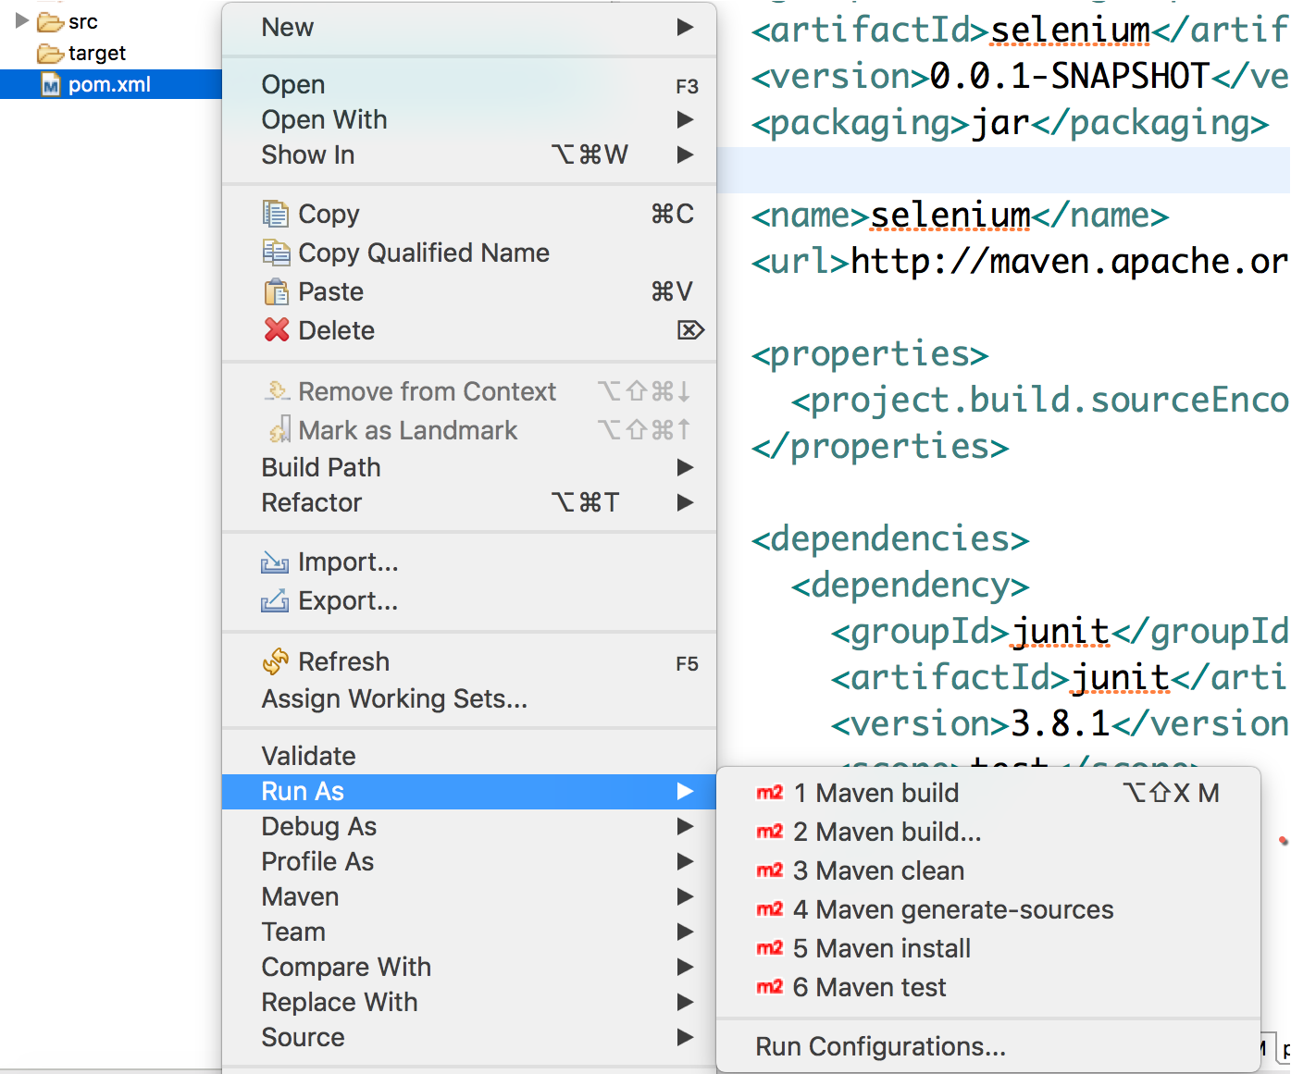

Slide 7
Maven Life Cycle
validate - validate the project is correct and all necessary information is available
compile - compile the source code of the project
test - test the compiled source code using a suitable unit testing framework. These tests should not require the code be packaged or deployed
package - take the compiled code and package it in its distributable format, such as a JAR.
verify - run any checks on results of integration tests to ensure quality criteria are met
install - install the package into the local repository, for use as a dependency in other projects locally
deploy - done in the build environment, copies the final package to the remote repository for sharing with other developers and projects.
mvn deploy:deploy-file -DgroupId=<group-id> \
-DartifactId=<artifact-id> \
-Dversion=<version> \
-Dpackaging=<type-of-packaging> \
-Dfile=<path-to-file> \
-DrepositoryId=<id-to-map-on-server-section-of-settings.xml> \
-Durl=<url-of-the-repository-to-deploy>

